Slide 1

DESIGNERY
Project 3
Presented by -
Divyansha arora

Slide 2
INTRODUCTION
To establish yourself as an interior designer it is important to have a good clientele.
The designers have a hard time to find their niche and start their own business.
At the other end the consumers find a hard time to seek guidance. There is always a struggle to get things
Being an architect I have often come across designers and clients not being able to be coherent with their aesthetics. For eg. an interior designer with minimalist approach wouldn’t work for a client who has a maximalist aesthetic.

Slide 3
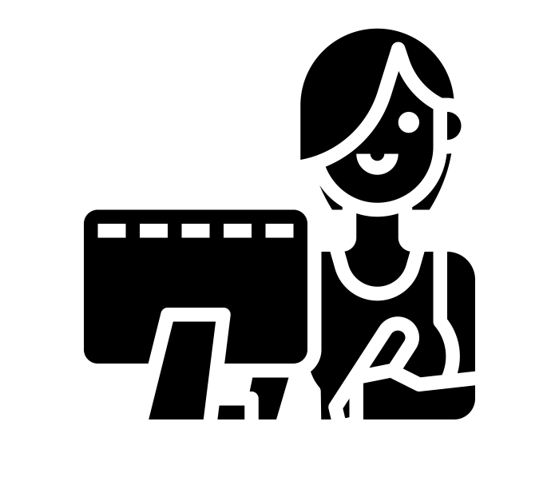
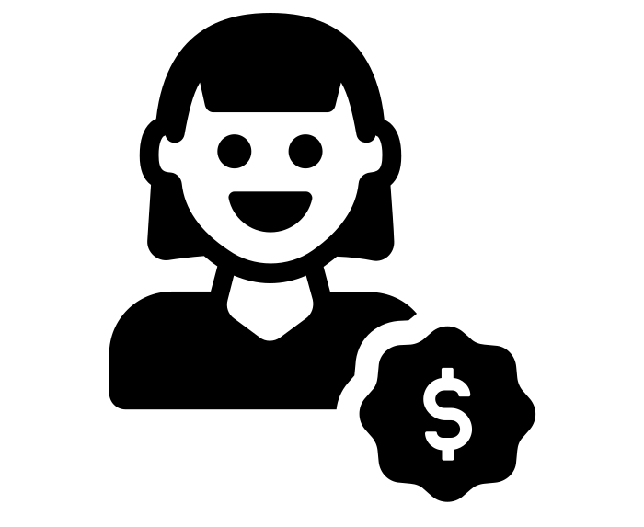
Who is it for?
Designers who are just starting out and want to build their brand.
Clients from Bourgeois sector of the economy seeking help with interior design decision making.

Slide 4
User research
Interview highlights
DESIGNERS
“Its so difficult to start out as a designer where you don’t have any industry experience or contacts.” miranda, interior design student
“The convention is to work in a small studio and create a good relationship with the clients,then start your own business. This could take 5-10 yrs.” Miriam,head architect at Miriam architects.
PROSPECT CLIENTS
“I always get so confused with what my aesthetic is and what will look good or bad with the furniture I already have.”- William,cook,just moved in to a new apartment.
“Space organisation is always a task! Having someone who can guide you with the process is always better.” Joane,home maker with two kids.

Slide 5
SOLUTION
A software app that helps to
Connect designers (who are starting out) to clients
Help people who want to design their spaces

Slide 6
USER PERSONAS
ANUSHKA VAIDYA, 24
SINGLE, GRADUATE STUDENT IN INTERIOR DESIGN AT PRATT
SINGLE, wants to start her own interior design studio.
NEEDS
BIO
Anushka is a hard working and passionate designer. She is an architect and studying interior design at Pratt. She loves to experiment with different cuisines. She loves to go out on dinners and enjoy quality time with friends and family.
To be able to create a clientele on her own
Network and talk to people in the industry to create contacts
PAIN POINTS
She finds tough to even think about catering all the resources to start her own
design firm.
Has a creative mind but doesn’t get time to
GOALS
Easier way to organise her work and projects
Simple ways to get in touch with clients and vendors
Generate multiple sources of revenue
Establish herself as a designer
RECOMMENDATIONS
To have a managing app that helps in revenue generation
Make revenue generation simpler
Easier to establish as a designer.

Slide 7
USER PERSONAS
Gloria refrigery, 36
WORKS WITH FOODHALL AS A MANAGER
SINGLE,wants to become a real estate broker
NEEDS
BIO
Gloria is a manager for now and she wants to break into the world of real estate. She has two kids and wants to invest in their upbringing. She spends most her days after work at home by herself.
She loves to decorate her house and keep adding new elements.
To be able to make a living for herself and her kids
To break into the profession of real estate
PAIN POINTS
She has a creative mind but barely gets time
Has a hard time to manage all the stuff from her kids and organise things
GOALS
To maintain a healthy lifestyle
To be able to workout with managing her life
Create multiple sources of income
RECOMMENDATIONS
Help to organise her life better

Slide 8






COMPETITIVE ANALYSIS
DIRECT COMPETITORS
INDIRECT COMPETITORS
In the design world, all of these platforms have crystalized as industry-leading spaces for designers to share their work.All of them the solve the same essential purpose - they offer space for designers to present their work - but they do it in different ways. Each of them has its own set of advantages and disadvantages.
People use these two platforms to search for searching for jobs and seeing the kind of work people do. Linkedin helps to see the background of people and instagram helps to see the designers

Slide 9
Key findings
THEY ARE ALL APPLICATIONS WHERE YOU CAN FIND ANY DESIGNER. THEY DON’T HAVE A NICHE.
THEY FOCUS ON CREATING A PLATFORM FOR DESIGNERS AND NOT THE CUSTOMERS.
THE FLOWS LACK CREATIVITY AND INTERACTION.

Slide 10
PROPOSAL
DESIGNERY
Your guide to the world of interior design.
Prototype link-
https://projects.invisionapp.com/prototype/cl2p8jed50002z401v087bwf0/play

Slide 11
FUTURE POTENTIAL
NOW
INTERIOR DESIGNERS WHO ARE STARTING OUT.
CLIENTS FROM BOURGEOIS SECTOR OF THE ECONOMY.
FUTURE
ALL INTERIOR DESIGNERS.
CLIENTS FROM ALL ECONOMIC BACKGROUNDS.

